Slide 1
How to Upgrade Your Program to the CSA Library
Common Simulation Architecture (CSA)
9/2/2010
Mike Sufana
Principal Investigator
Northrop Grumman Corporation

Slide 2
Contents
These charts document the steps required to upgrade your sim from the VSI_Library to the CSA_Library
TBD

Slide 3
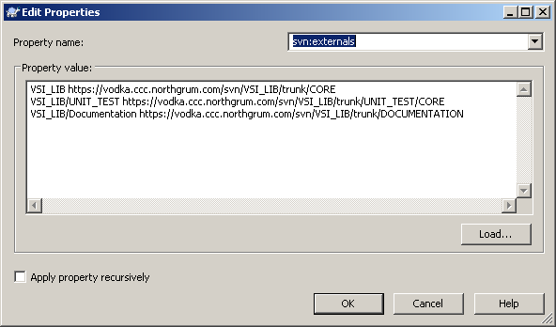
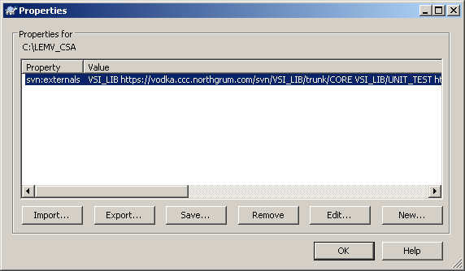
Upgrade from VSI_Library to CSA_Library

Slide 4
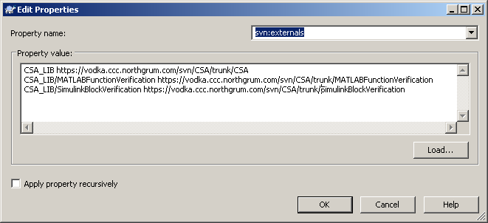
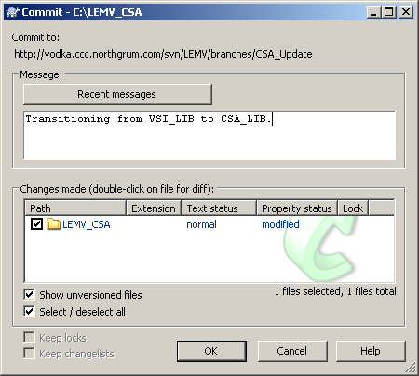

Slide 5
